Slide 1



IMAGE MODERATION
e-commerce platform
Cloud, AI: Rekognition, Bedrock
@TechWithNu

Slide 2
IMAGE MODERATION
e-commerce platform
Cloud, AI: Rekognition, Bedrock
@TechWithNu

Slide 3
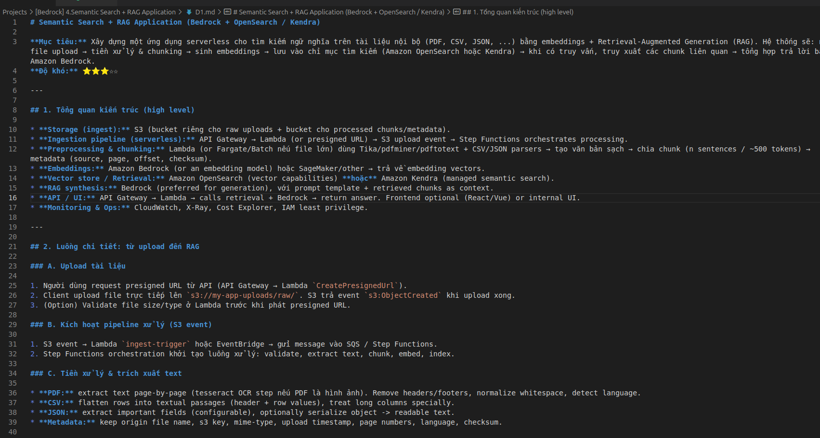
IMAGE MODERATION
e-commerce platform
Cloud,AI: Rekognition, Bedrock
@TechWithNu

Slide 4

IMAGE MODERATION
e-commerce platform
AI - Rekognition, Bedrock
@TechWithNu

Slide 5
🛒 Context
An e-commerce platform allows sellers to upload product images. However:
👉 Some images are invalid (contain competitor logos, sensitive text, violent content, or models wearing inappropriate clothing).
👉 Some images contain text (e.g., "SALE 70%", "Authentic Product") that needs to be analyzed for marketing purposes.
👉 Images need to be categorized into product groups (clothing, phones, cosmetics, food, etc.) to support automatic tagging.
@TechWithNu

Slide 6
🎯 Requirements
1. Image Moderation
Detect inappropriate content (violence, nudity, drugs, alcohol, etc.).
Reject images containing banned brand logos.
2. Text Recognition in Images (OCR)
Extract all text from images (e.g., "SALE", "100% Organic").
Analyze text meaning to detect spam or excessive promotions.
@TechWithNu

Slide 7
🎯 Requirements
3. Product Image Classification
Use Rekognition to detect the main object in the image.
Combine with Bedrock to interpret the object → assign product labels (e.g., “men’s shirt,” “smartphone,” “lipstick”).
4. Returned Results
Image status: ✅ Valid / ❌ Invalid.
Product group: (Clothing, Electronics, Cosmetics, etc.).
Metadata text extracted from the image.
@TechWithNu

Slide 8
🔧 Technology Solution
AWS S3 → store uploaded images.
AWS Lambda → process when a new image is uploaded.
AWS Rekognition →
`DetectModerationLabels` (image moderation).
`DetectText` (OCR).
`DetectLabels` (object detection).
@TechWithNu

Slide 9
🔧 Technology Solution
AWS Bedrock
Semantic analysis of OCR text.
Interpret detected objects into product labels aligned with the catalog.
AWS DynamoDB → store result metadata.
API Gateway → return results to web/app.
@TechWithNu

Slide 10
🚀 Workflow
1. Seller uploads image → S3.
2. Lambda triggers Rekognition:
Image moderation.
OCR text extraction.
Object detection.
@TechWithNu

Slide 11
🚀 Workflow
3. Send results to Bedrock:
Interpret text to detect spam/promotions.
Map objects into valid product labels.
4. Store metadata → DynamoDB.
5. API Gateway returns results to the admin system.
@TechWithNu

Slide 12
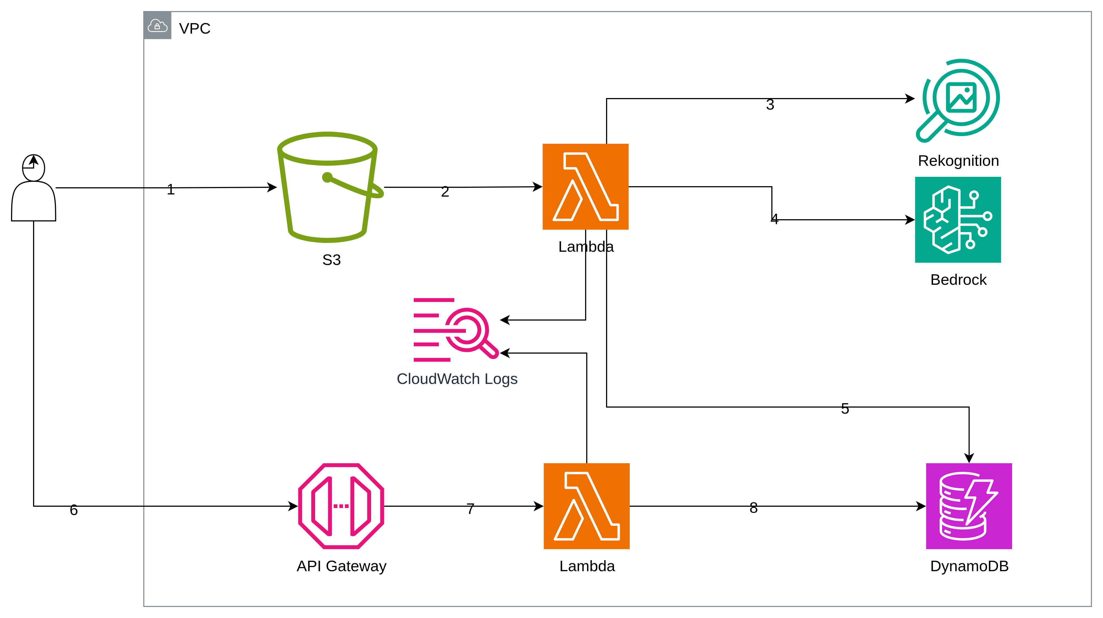
🛒 Flow chart
@TechWithNu

Slide 13
📋 Example Output
Input:
Uploaded image: `somi123.jpg`
Output:
Moderation result: ✅ Valid
OCR Text: `"SALE 50% Office Shirt"`
Product Label (Bedrock): `"Men’s Shirt"`
Final Status: Approved ✅
@TechWithNu

Slide 14




🛒 Example
50% OFF
APPROVED
BIG SALE
APPROVED
HOT GIRL
APPROVED
SMOKING
REJECTED
@TechWithNu

Slide 15
👉 Application deployment process
Step 1: Create an S3 Bucket
Bucket Name: `image-input`
Event Configuration: Configure the bucket to trigger a Lambda function whenever a new image is uploaded.
@TechWithNu

Slide 16
👉 Application deployment process
Step 2: Create a Lambda Function for Image Processing
Function Name: lambda-moderation-classification
Purpose: Process uploaded images (moderation, OCR, classification).
IAM Role: Assign a role with the necessary permissions (S3 read access, Rekognition, Bedrock, DynamoDB, CloudWatch logging).
@TechWithNu

Slide 17
👉 Application deployment process
Step 3: Configure Bedrock
Model Selection: Use Amazon Titan model `amazon.titan-text-express-v1`.
Purpose: Perform text analysis (OCR interpretation, spam/promotion detection, object-to-product label mapping).
Setup: Request access to the model if required.
@TechWithNu

Slide 18
👉 Application deployment process
Step 4: Create DynamoDB Table
Table Name: `image-metadata-table`
GSIs:
Name: StatusIndex
PartitionKey: final_status
SortKey: timestamp
Schema Definition:
@TechWithNu

Slide 19
```schema
TableName: image-metadata-table
PrimaryKey:
PartitionKey: s3_key (String)
SortKey: timestamp (Number) # optional
Attributes:
- s3_key: String - labels: List<String>
- ocr_texts: List<String>
- moderation: List<String>
- bedrock: Map
- final_status: String
- timestamp: Number
GSIs:
- Name: StatusIndex
PartitionKey: final_status
SortKey: timestamp```
* **Purpose:** Store metadata results for moderation, OCR text, product labels, and final status.
@TechWithNu

Slide 20
👉 Application deployment process
Step 5: Check CloudWatch
Setup: Ensure the Lambda function writes logs to a CloudWatch log group.
Purpose: Monitor execution, debug errors, and validate processing during tests.
@TechWithNu

Slide 21
👉 Application deployment process
Step 6: Create API Gateway for Retrieval
Endpoint: `GET /images?status=APPROVED`
Lambda Integration: Create a Lambda function that queries DynamoDB based on `final_status`.
IAM Role: Assign a role with permission to query DynamoDB and log to CloudWatch.
Purpose: Provide an API for the web or admin system to fetch approved images.
@TechWithNu

Slide 22
👉 Application deployment process
Step 6: Create API Gateway for Retrieval
API Name: moderation-classification.
Resource: images.
Proxy Intergration: Enable.
Stage: workflow.
@TechWithNu

Slide 23
🌐 Suggestions for Production Expansion
👉 Add a queue (SQS) if handling a large number of images or to prevent bottlenecks.
👉 Implement retry/backoff mechanisms for Bedrock/Rekognition calls.
👉 Add a whitelist/blacklist logo check (using image matching or embedding + similarity).
👉 Provide additional APIs (API Gateway + Lambda) to query image lists by score or with filters.
👉 Record events into an audit log and visualize them in a dashboard (CloudWatch / QuickSight).
👉 Install CICD, Terraform.
@TechWithNu

